Slide 1
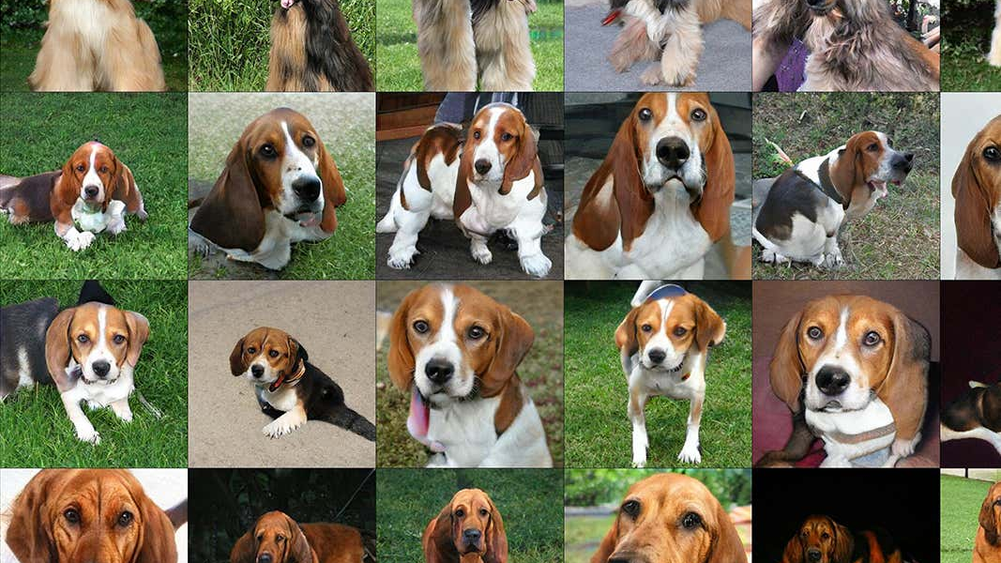
GANs Presentation - Dog Image Generation Problem
By: George Aeillo, Eric Nguyen, Arun Agarwal

Slide 2
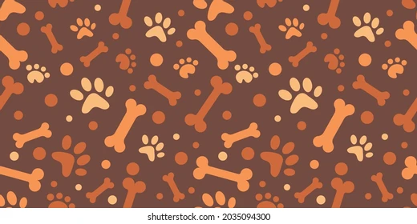
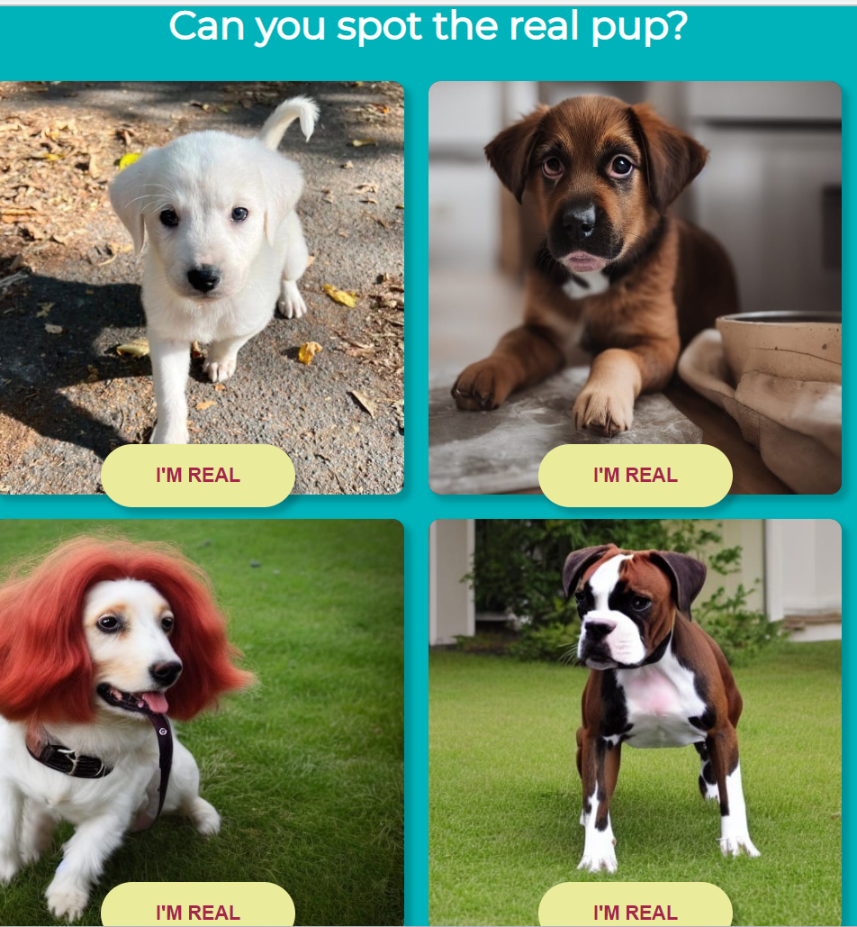
Dog Trivia!

Slide 3
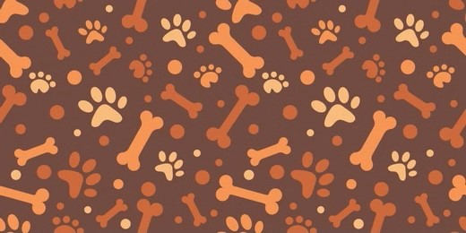
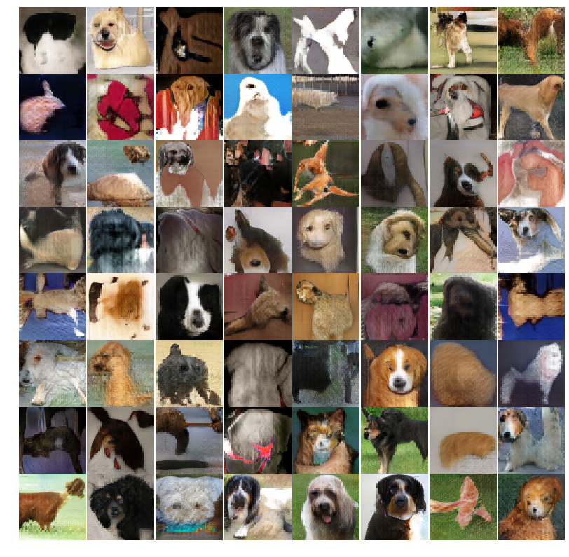
Data Science Problem
Traditional supervised learning task- requires user to identify dogs or different breeds of dogs
This competition - challenges user to develop an algorithm that generates realistic dog images
Due to the nature of this task, GANs (Generative Adversarial Networks) are a key tool that can help solve this problem
“You might not think that programmers are artists, but programming is an extremely creative profession. It’s logic-based creativity” - John Romero

Slide 4
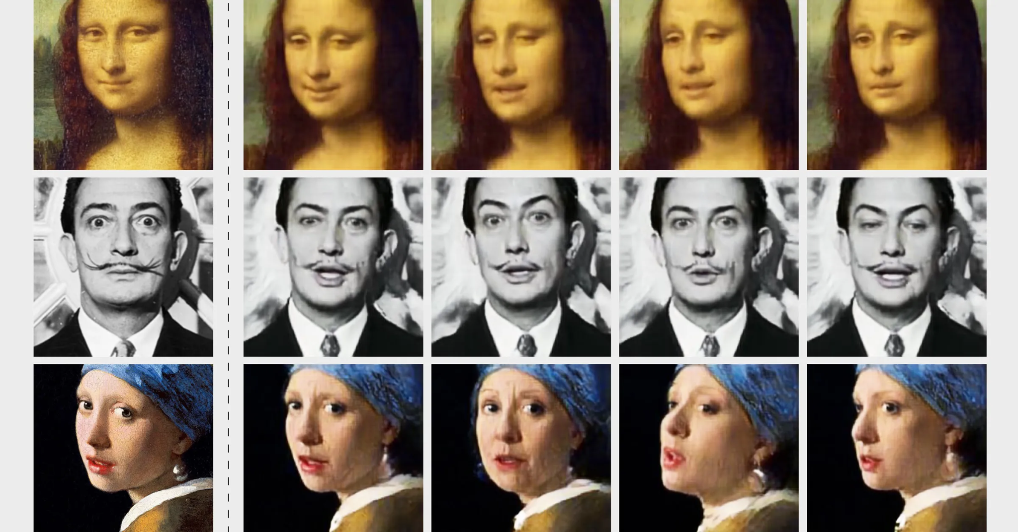
Importance of Problem
This problem belongs to a broader class of problems known as generative modeling
Generative modeling has a variety of applications in art, advertising, and it provides an innovative experience for users
While the pictures of dogs may seem trivial, methods that have higher performances on this task may be used in a variety of real-world applications, such as deep-fake generation

Slide 5
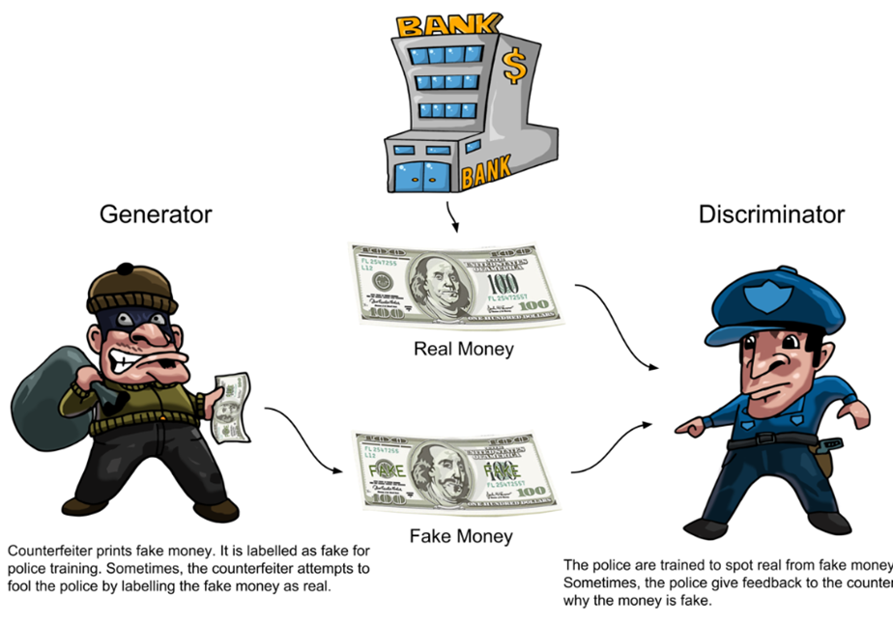
GAN (Generative Adversarial Network) Overview

Slide 6
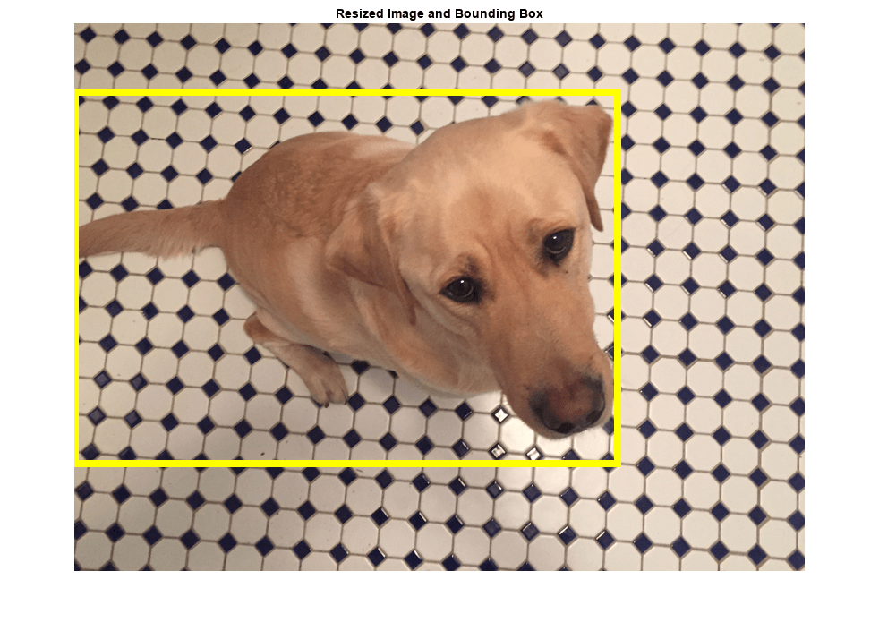
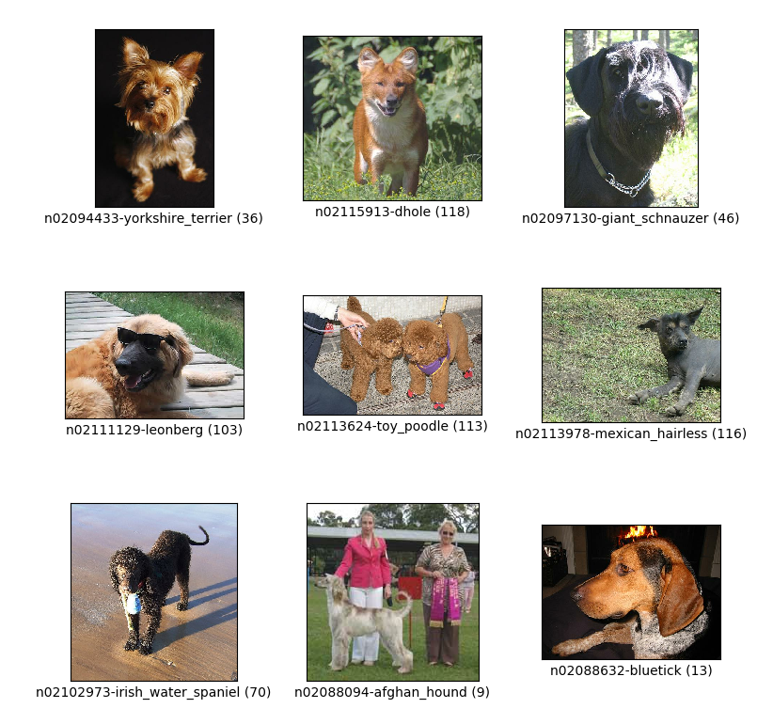
Training Data For Competition
Data from the Stanford Dogs Dataset
External data cannot be used for training
This training data comes in the form of two files
all-dogs.zip is a zip file that contains about 20,500 images of dogs
Annotations.zip is a file that contains the class label and bounding box for each image Bounding box - coordinates that give the location of the dog in the image

Slide 7


Classification Labels
Images and annotations downloaded from ImageNet
Generative learning - typically unsupervised learning
Class labels are generally discarded in most submissions (even with 120 dog species annotations)
Data comes with bounding box (from Amazon Mechanical Turk)
The user submits 10,000 generated dog images with no labels (PNG format)
Size: 64x64x3 (RGB); will zip images into one file: “images.zip”

Slide 8
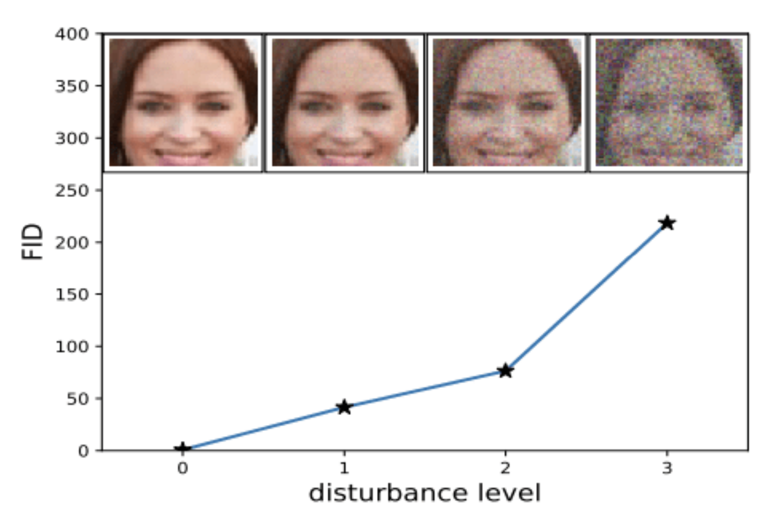
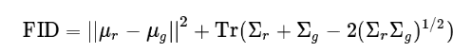
Evaluation Metric
Success measured with Memorization-informed-Fréchet Inception Distance (MiFID)
Kaggle-created metric that is a modification of FID
FID:
Assesses the quality of images created by a generative model (ex: GAN)
Compares distribution of generated images with distribution of real/ground truth images
Mean 𝜇, covariance Σ, real images r, generated images g, sum of diagonal elements Tr

Slide 9
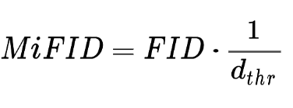
Evaluation Metric Continued
Kaggle modification: takes into account memorization distance
Minimum cosine distance of training samples in feature space, averages over all user-generated image samples
Threshold: assigned a value of 1 if distance exceed a pre-defined epsilon
MiFID:
FID multiplied by inverse of memorization distance (with implemented threshold)
Note: Kaggle calculates public and private MiFID scores with same code, but with different pre-trained models and evaluation images
Public: model - Inception, images - ImageNet Dogs
Private: undisclosed

Slide 10
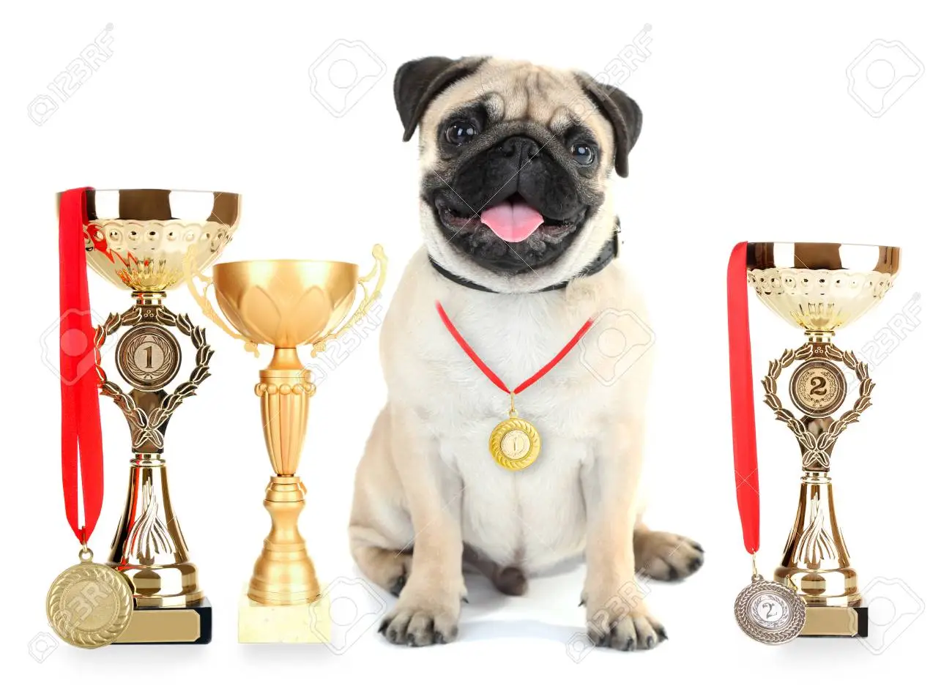
Winning Solution Overview
927 Teams participated, 12,306 entries
Participants had approx. 1 year
1st-5th place winners each received $2000
The winning solution had a MiFID score of 55.42142

Slide 11
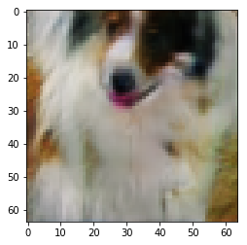
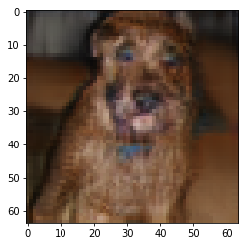
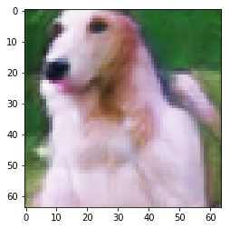
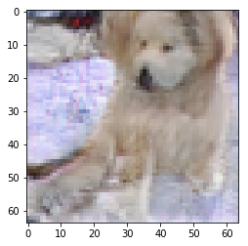
Feature Engineering and Data Augmentation Techniques For Winning Model
Preprocessing:
Images cropped to bounding box
Omit cropped images with extreme aspect ratio
Omit images where dog’s face is obscured
Augmentations:
Image resized to 64 on one side
Random horizontal flip (50%)
Randomly crop to 64x64

Slide 12

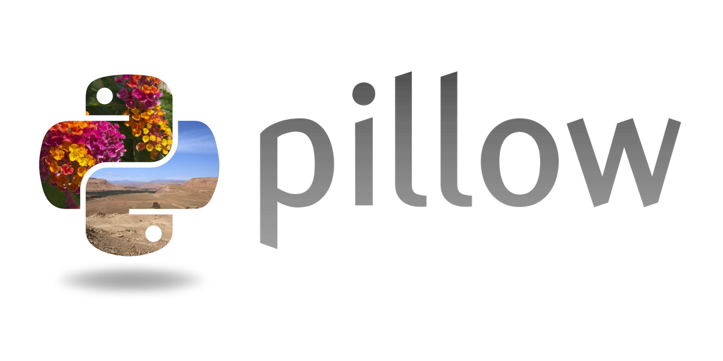



Libraries and Tools For Winning Model

Slide 13
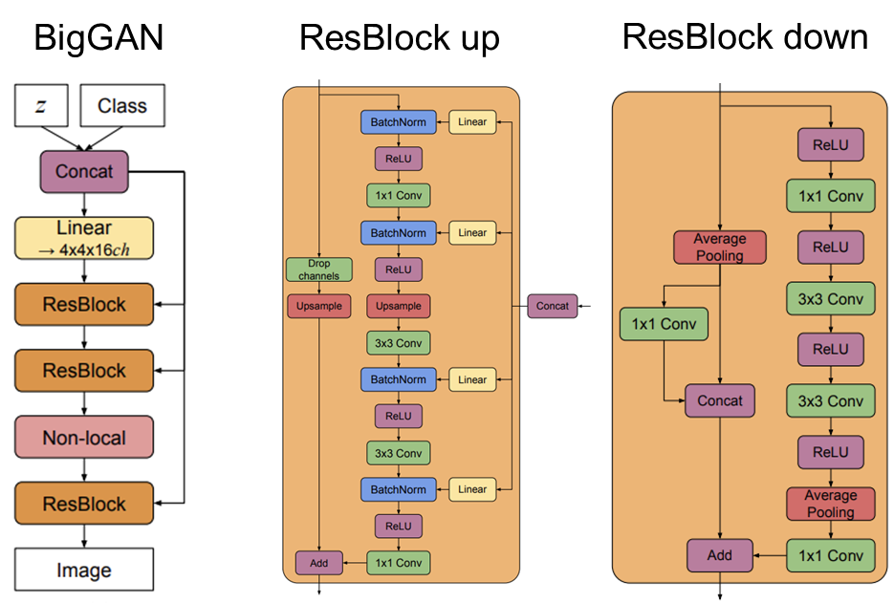
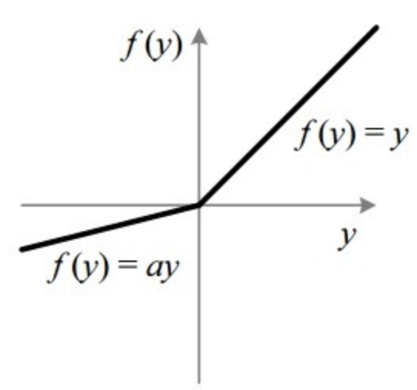
Algorithms For Winning Model
BigGAN + LeakyReLU
Innovations of BigGAN:
Increased batch sizes and width of each layer
Skip connections

Slide 14
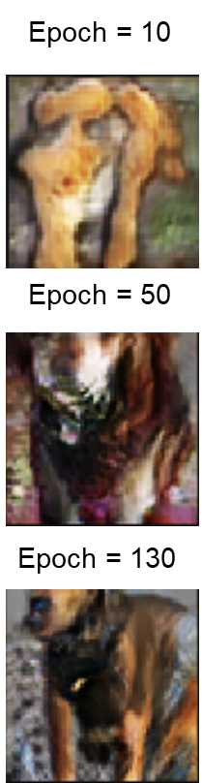
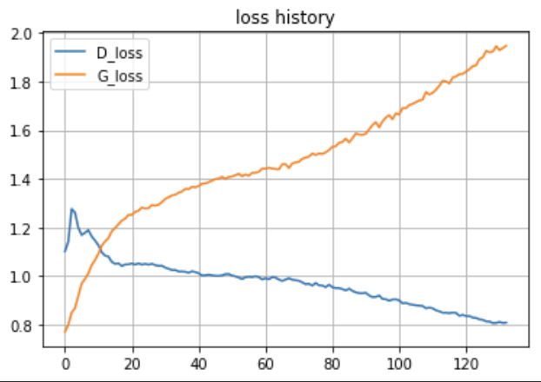
Training For Winning Model
10 million generator parameters
8 million discriminator parameters
Loss: BinaryCrossEntropy
Optimizer: Adam
Batch Size = 32

Slide 15
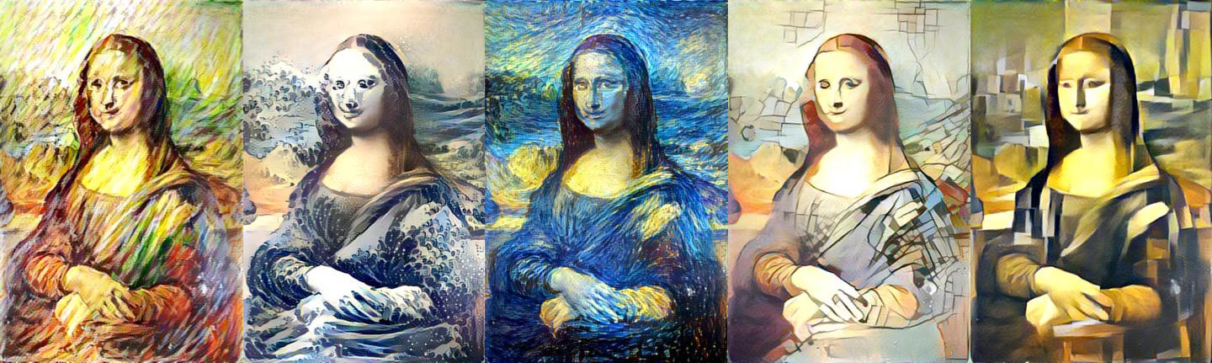
Differences From Our Project
Our project is focused on style-transfer, which focuses on translating an image into a different-style (ex: brush-strokes)
Also, the use of bounded boxes in this project to focus on a specific part of an image would not apply to our project, as we are trying to modify the entire image
This project had about 10,000 training samples, while our task only initially has about 300 Monet painting samples

Slide 16
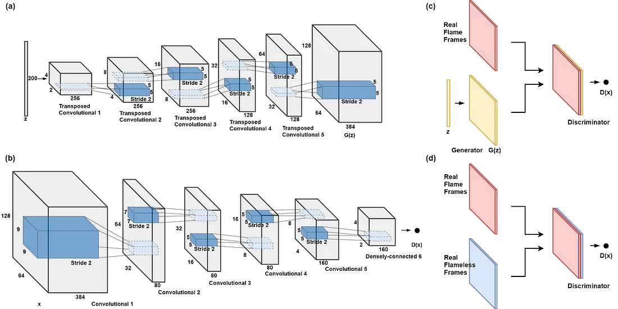
Applications To Our Project
GAN Architecture
Image processing
GAN Development
Pytorch
Data/Image Augmentation
Data/Image Visualization

Slide 17
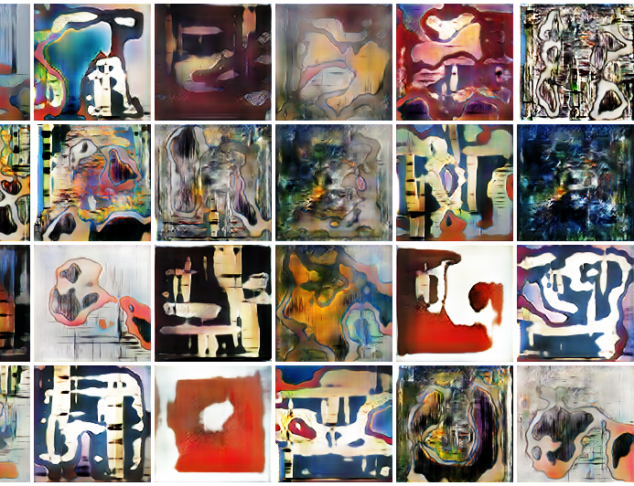
Topics/Technologies of Further Interests
Image augmentation
PyTorch
Variety in GAN models
Generative Images
Generative AI
Video games
Movies
Fashion
Advertising

Slide 18
References
This Dog Exists, The Others Do Not
Generative Dog Images | Kaggle
Stanford Dogs dataset
Working Principles of Generative Adversarial Networks (GANs) - DZone
Fréchet Inception Distance
A Simple Explanation of the Inception Score
Tom Solution Dog Gan
DCGANs — Generating Dog Images with Tensorflow and Keras | by Konstantin Georgiev | Towards Data Science
FID Disturbance Chart
Dog Bounding Box
ImageNet
Leaky ReLU
Deepfakes Are Getting Better. But They're Still Easy to Spot | WIRED
Pytorch Logo
Matplotlib Logo
DCGAN Under 100 Lines of Code. Although Deep Convolutional GAN has… | by Himanshu Dutta | The Startup | Medium
Style transfer (ml4a.github.io)
Torch Vision Logo
Pillow Library Logo
NumPy Logo
stanford_dogs | TensorFlow Datasets
Dog with Trophies

